Slide 1

Computer Networks: Devices, types, topologies
School of Computer Science Engineering and Technology Bennett University
Greater Noida – 201310

Slide 2
Outline
Networking devices
Network types
Network topologies

Slide 3
Networking devices
NIC Hub Bridge Switch | Repeater Router Gateway Firewall

Slide 4
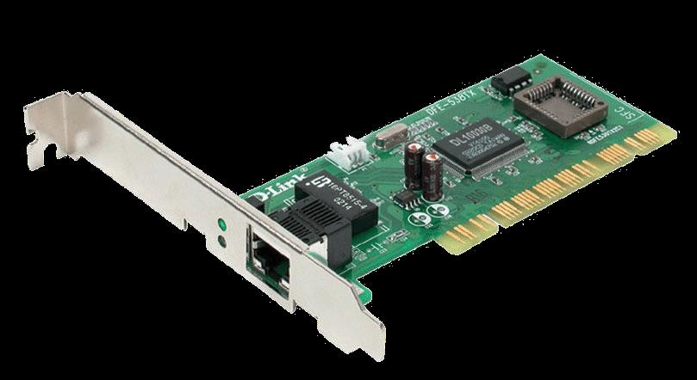
Networking devices: NIC
NIC is used to connect host devices to the network media.
A NIC is a printed circuit board that fits into the
expansion slot of a bus on a computer motherboard.
It can also be a peripheral device.
NICs are sometimes called network adapters.
Each NIC is identified by a unique code called a Media Access Control (MAC) address.
This address is used to control data communication for the host on the network.
Which NIC you are using right now to attend the lecture?

Slide 5
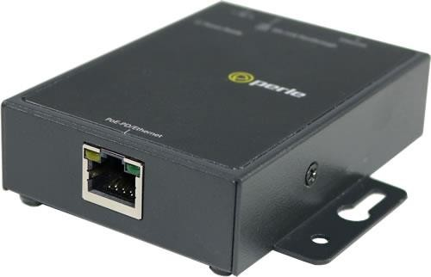
Networking devices: Repeater
A repeater is a network device used to regenerate a signal.
Repeaters regenerate analog or digital signals that are distorted by transmission loss due to attenuation.
A repeater does not make an intelligent decision concerning forwarding packets

Slide 6
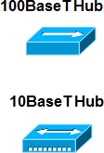
Networking devices: Hubs
Hubs concentrate on connections.
Hubs take a group of hosts and allow the network to see them as a single unit. This is done passively, without any other effect on the data transmission.
Active hubs concentrate hosts and also regenerate signals.

Slide 7
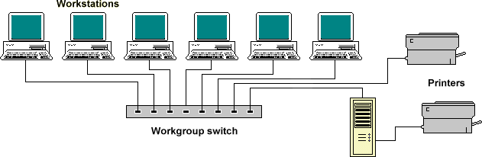
Networking devices: Switches
Switches add more intelligence to data transfer management.
Determine if data should remain on a LAN and transfer data only to the connection that needs it.
A switch is a multiport bridge with a buffer and a design that can boost its efficiency.
A switch is a data link layer device.
The switch can perform error checking before forwarding data.

Slide 8
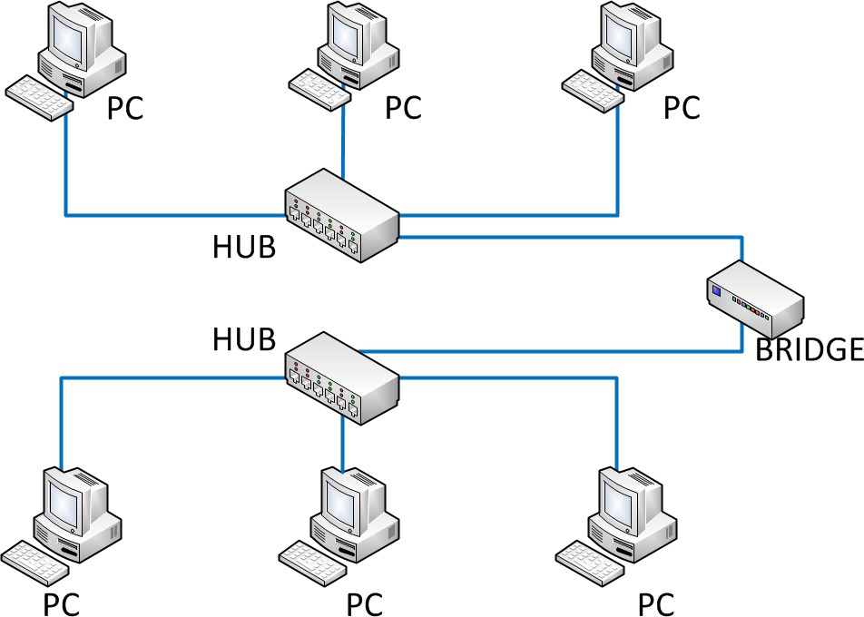
Networking devices: Bridges
A bridge is a repeater, with add on the functionality of filtering content by reading the MAC addresses of source and destination.
Bridges provide connections between LANs working on same protocol.
A bridge operates at the data link layer.
It has a single input and single output port, thus making it a 2 port device.

Slide 9
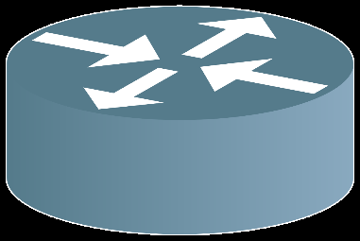
Networking devices: Routers
A router is a device or a hardware which is
responsible for
receiving, analyzing and
forwarding
the data packets to other networks.
It is used in the LAN and WAN domain.
A router operates on layer 3 and layer 4 of the OSI model.
A router installs routing details for multiple networks and routing traffic based upon the destination address.

Slide 10
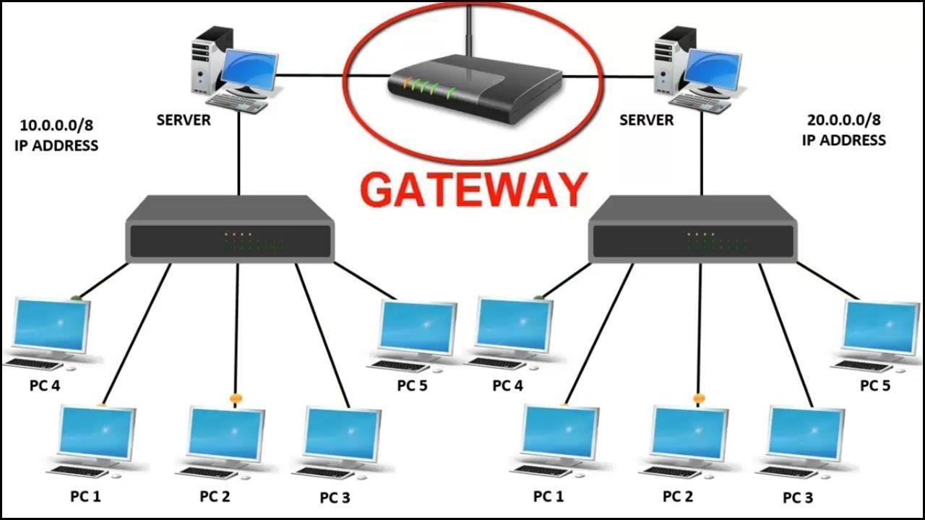
Networking devices: Gateways
A device used for the communication among the networks which have a different set of protocols.
It is used to communicate using multiple protocols to connect a bunch of networks
A gateway operates up to layer 5 of the OSI model.
It is used to differentiate what is inside the network and what is outside the network.

Slide 11
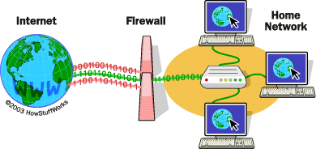
Networking devices: Firewall
A firewall is a network device/software for controlling security and access rules.
Firewalls are placed internal networks and external networks such as the Internet.
Firewalls are typically configured to reject access requests from unrecognized sources while allowing actions from recognized ones.

Slide 12
Network Types
Personal Area Network (PAN)
Local Area Network (LAN)
Metropolitan Area Network (MAN)
Wide Area Network (WAN)

Slide 13
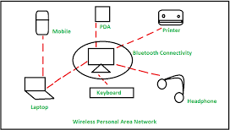
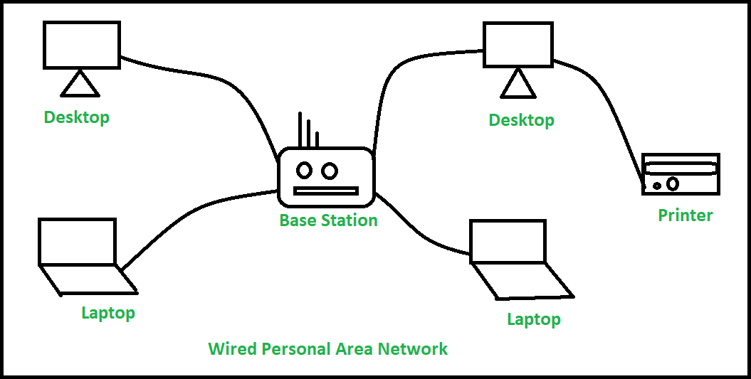
Network Types: PAN
Deployed mainly in a home environment, connecting one or more computers, printers, phones, other personal gadgets through modem either in wired or wireless mode.
It serves the purpose of sharing documents & photos within nodes, accessing the internet and entertainment.

Slide 14
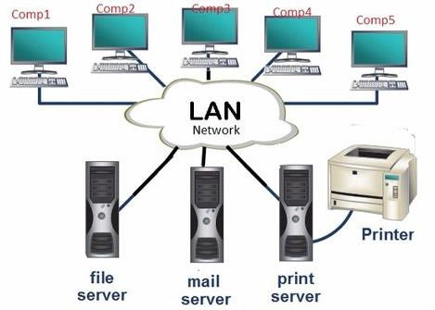
Network Types: LAN
LAN connects computers and other equipment within a premise or building.
Computers and devices are connected through Hub, switches, network adapters, cables, and optic fibers.
In modern LAN, computers are connected in wireless mode through access points (Antenna)
A LAN can be logically split into multiple
Virtual local area networks (VLANs).

Slide 15
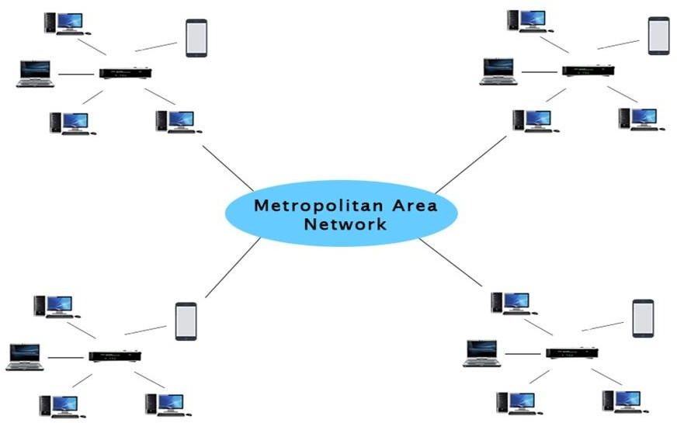
Network Types: MAN
MAN is a network that covers a larger geographic area by interconnecting a different LAN to form a larger network.
In MAN, various LANs are connected to each
other through a telephone exchange line.
The most widely used protocols are RS-232, Frame Relay, ATM, ISDN, etc.
Communication between the banks in
Use cases:
a city, airline reservation, communication in the military.

Slide 16
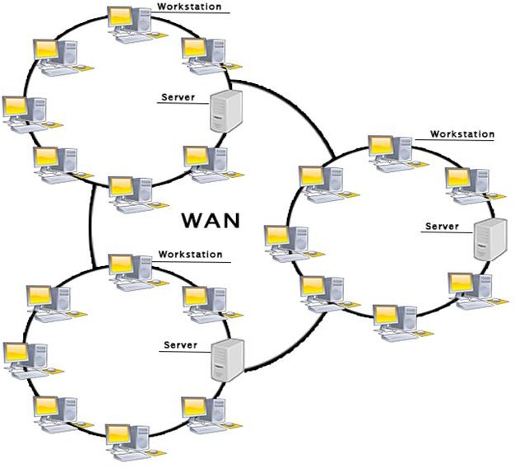
Network Types: WAN
WAN extends over a large geographical area such as states or countries.
WAN spans over a large geographical area through a telephone line, fiber optic cable or satellite links.
Internet is one of the biggest WAN in the world.
WAN is widely used in the field of Business, government, education, sharing of message, software and resources, global business, high bandwidth

Slide 17
Network Topology
Bus
Ring
Star
Tree(Hierarchical)
Mesh
Hybrid

Slide 18
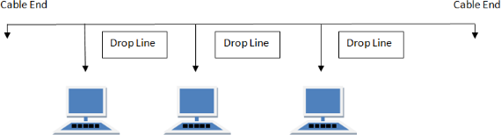
Network Topology : Bus
Devices are connected to a central cable, called bus or backbone. Terminators at each end of the bus stops signal and keeps it from traveling backwards.
No of cables = N+1, Ports = N
Benefits:
It is cost-effective.
The Cable length
Drawbacks:
If the main cable collapses, the complete network collapses.
The performance is at stake for heavy network
traffic and large number of nodes.
The length of the cable is limited.
It is not as fast as Ring Topology.
required is the least in
comparison to other topologies.
Easy to understand.
Expansion can be done easily by linking the
cables together.

Slide 19
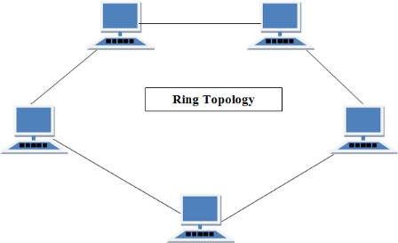
Network Topology: Ring
The main computer is known as the monitor station, responsible for all the operations and transmission amongst devices is done with the help of tokens.
The computer station has to hold the token for the transmission.
The token is released only when the transmission is complete.
Data transmission is done in a sequential method.
Each pair of stations has a point-to-point connection
Each device incorporates a repeater.
The data transmission is unidirectional in a Ring topology, but it can be created to be bidirectional.
No of cables = N, No of Ports = 2N

Slide 20
Network Topology : Ring
Drawbacks:
It is a tedious task to troubleshoot in Ring topology.
It is difficult to add or delete nodes, as it interrupts the network activity.
If one computer crashes, the entire network activity is disrupted.
Benefits:
The network is not affected by numerous nodes or heavy traffic, as only the nodes possessing tokens can transfer data.
Ring topology has cheap installation and expansion.

Slide 21
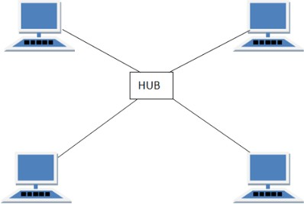
Network Topology : Star
All the nodes are connected via cables to a single node called a hub.
The hub can be active or passive in nature.
Active hubs contain repeaters, while passive hubs are considered non-intelligent nodes.
Each node contains a reserved connection to the central node, which the central node acting as a repeater during data transmission.
No. of cables = N, No. of ports = N

Slide 22
Network Topology : Star
Benefits:
Easy to install and reconfigure.
Robustness, if one link fails; only that link is affected. All other links remain active.
Easy fault identification and isolation. As long as the hub is working, it can be used to monitor link problems and bypass defective links.
Drawbacks:
The devices are not linked to each other.
If one device wants to send data to another, it sends it to the controller, which then relays the data to the other connected device

Slide 23
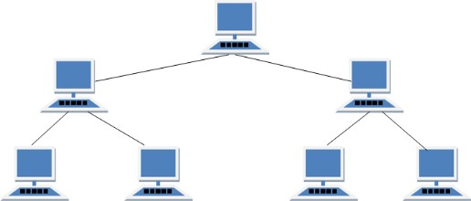
Network Topology : Tree/ Hierarchal
Nodes are connected hierarchically, with all the nodes connected to the topmost node or root node.
Tree topology has at least three levels of hierarchy.
It is an extension of Bus topology and Star topology.
It is best if the workstations are situated in groups, for easy working and managing.

Slide 24
Network Topology : Tree/Hierarchal
Benefits:
It allows more devices to be attached to a single central hub and can therefore increase the distance a signal can travel between devices.
It allows the network to isolate and prioritize communications from different computers.
Drawbacks:
It is profoundly cabled.
Expensive compared to other topologies.
If the root node collapses, the network will also
collapse.

Slide 25
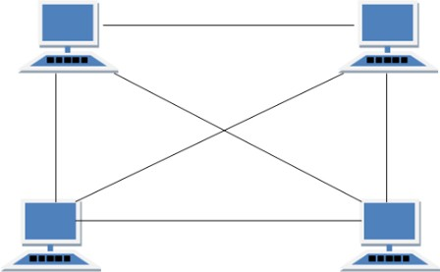
Network Topology : Mesh
All the nodes are connected with all the other nodes via a network channel.
Mesh topology is a point-to-point connection.
Mesh topology has two techniques for transmission of data, i.e., routing and flooding.
No of cables = N * (N-1)/2
No. of ports = N * (N-1)

Slide 26
Network Topology : Mesh
Benefits:
Every connection has the ability to carry its
particular data load.
Mesh Topology is very robust.
It is easy to diagnose faults.
Mesh Topology provides privacy and security.
Drawbacks:
Mesh Topology is challenging to install and
configure.
As all the nodes are connected with each other, cabling is costly.
Bulk wiring is essential.

Slide 27
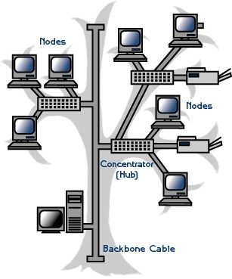
Network Topology : Hybrid
Comprising of two or more different types of topologies.
It is a reliable and scalable topology, but simultaneously, it is a costly one.
It receives the merits and demerits of the topologies used to build it.

Slide 28
Network Topology : Hybrid
Benefits:
It is easy to troubleshoot and provides simple
error-detecting techniques.
It is a flexible network topology, making it quite effective.
It is scalable since the size can be made greater easily.
Drawbacks:
t isn’t very easy to design it.
It is costly, as it involves more than one topologies.

Slide 29
References
https://www.javatpoint.com/types-of-computer-network
https://www.belden.com/blogs/network-types
https://www.geeksforgeeks.org/types-of-network-topology/
https://www.javatpoint.com/computer-network-topologies
https://www.youtube.com/watch?v=uSKdjjw5zow
https://www.youtube.com/watch?v=9BIN99rHOCQ
https://www.youtube.com/watch?v=0pMm_QxCg3I

